Slide 1

Ego Network analysis Social Networks and Health Duke University, 2018
Brea L. Perry
Professor of Sociology
Indiana University Network Science Institute

Slide 2
roadmap
Common measures and when to use them
Data management for ego networks
Regression with ego net variables
Multilevel modeling
Ego network dynamics

Slide 3
COMMON MEASURES IN EGOCENTRIC NETWORK ANALYSIS

Slide 4
Measurement
Ego network measures are based on:
Ego-alter ties
Alter attributes
Alter-alter ties

Slide 5
Ego-alter ties
Degree
Number of alters to whom ego has a direct connection (i.e. network size)
Can be interpreted as a measure of social integration, social capital, social activity, or prominence
BUT can be good or bad - what ego is getting more of with each additional alter?

Slide 6
Ego-alter ties
Degree
Must be cautious because it is highly dependent on name generator strategy (esp. numeric limits)
Can compare size within your sample, but not to other samples
Don’t want to double count in multiple name generator strategy
May choose not to count all types of ties (e.g. political discussants vs. support networks)

Slide 7
Ego-alter ties
Multiplexity
Overlap between the functions of ties or the ways that an alter is related to ego
E.g. coworker → friend
Affectively stronger, more motivation to maintain
Multiplex ties associated with higher self-esteem, psych adjustment, satisfaction with relationships

Slide 8
Ego-alter ties
Multiplexity
Can examine freq or presence of specific combinations
E.g. to compare groups…gender and “framily” members
Can use as a measure of tie strength by counting ways connected or functions
E.g. are ties with higher multiplexity less likely to dissolve over time

Slide 9
Ego-alter ties
Tie strength
Captures intensity, duration, affective qualities
Closeness, freq of contact, length of relationship, important matters, strength
Presence of strong ties = integration or regulation
Presence of weak ties = bridging potential, access to novel resources

Slide 10
Ego-alter ties
Tie strength
Avg strength of tie
E.g. if measuring neighborhood ties, operationalize community engagement
Count of strong or weak ties
Other measures of central tendency (e.g. max)
Standard deviation
Notes:
It may also be useful to look at the standard deviation of tie strength (or any other measure of dispersion). We might theorize that coping with the varied eventualities of life is optimized by having a portfolio of tie strengths. For example, it might be that strong ties are valuable for their reliability and their motivation to help, but not for the freshness of their perspective. As discussed throughout this book, we often have strong ties with people who are very similar to ourselves, and therefore are not good sources of alternative perspectives. In contrast, weak ties can be quite different from ourselves, providing new information that is beneficial in a variety of contexts (e.g. among entrepreneurs).

Slide 11
Ego-alter ties
Other relationship characteristics
Can be calculated and used similarly to tie strength
E.g. frequency, central tendency, SD
May be functions - stuff alter does for/to ego, or ego does for/to alter (e.g. support, regulation)
May be presence of other shared activities (e.g. sex, drug use, political discussion)
Notes:
It may also be useful to look at the standard deviation of tie strength (or any other measure of dispersion). We might theorize that coping with the varied eventualities of life is optimized by having a portfolio of tie strengths. For example, it might be that strong ties are valuable for their reliability and their motivation to help, but not for the freshness of their perspective. As discussed throughout this book, we often have strong ties with people who are very similar to ourselves, and therefore are not good sources of alternative perspectives. In contrast, weak ties can be quite different from ourselves, providing new information that is beneficial in a variety of contexts (e.g. among entrepreneurs).

Slide 12
Alter attributes
Composition
Reflects content - material and nonmaterial resources, knowledge, behaviors, and cultural characteristics (i.e. ideas, attitudes, values)
Social influence
E.g. Obesity, smoking, drinking, and happiness are “contagious”
Access to social capital
E.g. People are more likely to get a job at Google if they know someone in the tech industry
Broader patterns of interaction in society
E.g. People with more education have more educated networks

Slide 13
Alter attributes
Composition (categorical)
Proportion for strength or direction of influence
E.g. proportion network democrat/republican
Count for access to specific resources
E.g. number of people who can help you move – more is always better, regardless of proportion

Slide 14
Alter attributes
Composition (continuous)
Central tendency for summarizing content
E.g. average or median income for social class
Min/max for access
Max income for starting a business
SD for diversity
SD of income for exposure to lots of different ideas

Slide 15
Alter attributes
Ego-alter similarity
Three different mechanisms of similarity
1) Preference - people tend to socialize and form bonds with others like them (homophily)
Ease of communication
Racism, sexism, etc.
Primitive survival instinct to fear outsiders

Slide 16
Alter attributes
Ego-alter similarity
Three different mechanisms of similarity
2) Availability - people tend to socialize and form bonds with people they come into contact with (shared foci of activity)
Racial and SES segregation in housing
Gender segregation in occupations and interests

Slide 17
Alter attributes
Ego-alter similarity
Three different mechanisms of similarity
3) Influence - people become more similar over time through repeated social interactions
Applies only to achieved statuses (e.g. attitudes, decisions, behaviors), not ascribed ones (e.g. race, gender)

Slide 18
Alter attributes
Ego-alter similarity
Homophily insulates ego from outside influence and ideas and reinforces in-group behaviors and biases
E.g. political polarization
Homophily is identity-affirming, fostering a sense of comfort and belonging
Can be used to impute ego characteristics (e.g. criminality, sexuality)
Can measure social influence over time

Slide 19
Alter attributes
Ego-alter similarity (categorical)
Proportion same as ego
E.g. if you are female and 3 out 4 of alters are female, proportion homophilous is .75
Krackhardt and Stern’s E-I
Ego’s propensity to have ties to alters with same characteristic
-1 to 1 where -1 = completely homophilous and 1 = completely heterophilous
N_{external}-N_{internal}
network size

Slide 20
Alter attributes
Ego-alter similarity (categorical)
BUT homophily is dependent on the availability of different alters
Treat distribution in community at large as expected value in a null model of no homophily
E.g. Suppose neighborhood is 75% white, what is expected number of white ties given the lower availability of minorities in the community

Slide 21


Alter attributes
Ego-alter similarity (categorical)
Phi (normalized chi-square)
1) Calculate expected value
If degree is 12, and neigh is 75% white, expect 0.75*12 = 9 white alters, 3 minority
2) Calculate chi-square
(10-9)²/9= 0.11 + (2-3)²/3= 0.33 for a sum of 0.44
3) Normalize so value (phi) ranges from 0-1
Sqrt 0.44/12 = 0.19
$$χ^{2}=\sum_{k}{\frac{{\left(O_{k}−E_{k}\right)}^{2}}{E_{k}}}$$
$$φ=\sqrt{\frac{χ^{2}}{N}}$$

Slide 22
Alter attributes
Ego-alter similarity (continuous)
Average Euclidean Distance
Is mean squared differences between ego and alters
Just like SD, but measures deviation around ego instead of deviation around the mean
Higher = ego is more dissimilar (more “distant”) from alters

Slide 23

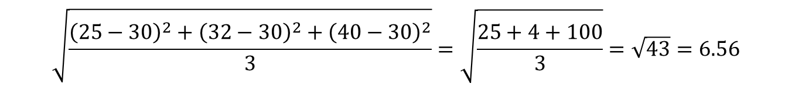
Alter attributes
Ego-alter similarity (continuous)
Average Euclidean Distance on age
Where k indexes alters, a_{k} is the age of alter k, and e is age of ego
30-year old ego has three alters aged 25, 32, and 40
Only compare egos to other egos since scale depends of variable
$$\sqrt{\frac{\sum_{k}{{\left(a_{k}−e\right)}^{2}}}{n}}$$
$$\sqrt{\frac{{\left(25−30\right)}^{2}+{\left(32−30\right)}^{2}+{\left(40−30\right)}^{2}}{3}}=\sqrt{\frac{25+4+100}{3}}=\sqrt{43}=6.56$$

Slide 24
Alter attributes
Heterogeneity or “range”
Similarity of alters to each other rather than to ego
Heterogeneous network provides access to a larger set of non-redundant social resources
Advantageous for instrumental actions like gathering information
May indicate participation in diverse social spheres that cross social, institutional, or organizational boundaries
Racial/ethnic heterogeneity is important for outcomes like cultural awareness, reduced in-group bias, cultivation of multiple ethnic identities, and continued interracial contact

Slide 25
Alter attributes
Heterogeneity (categorical)
Blau’s Index (Herfindahl’s or Hirschman’s index)
Probability that two randomly selected individuals from a group belong to different categories
Ranges from 0-1 with higher scores indicating more heterogeneity

Slide 26

Alter attributes
Heterogeneity (categorical)
Blau’s Index
Where p_{k} is the proportion of ego’s alters in category k
As number of categories increases, potential Blau’s Index increases. Max is:
$H=1− \sum_{k}{p_{k}^{2}}$
$$\left(1−\frac{1}{k}\right)$$

Slide 27
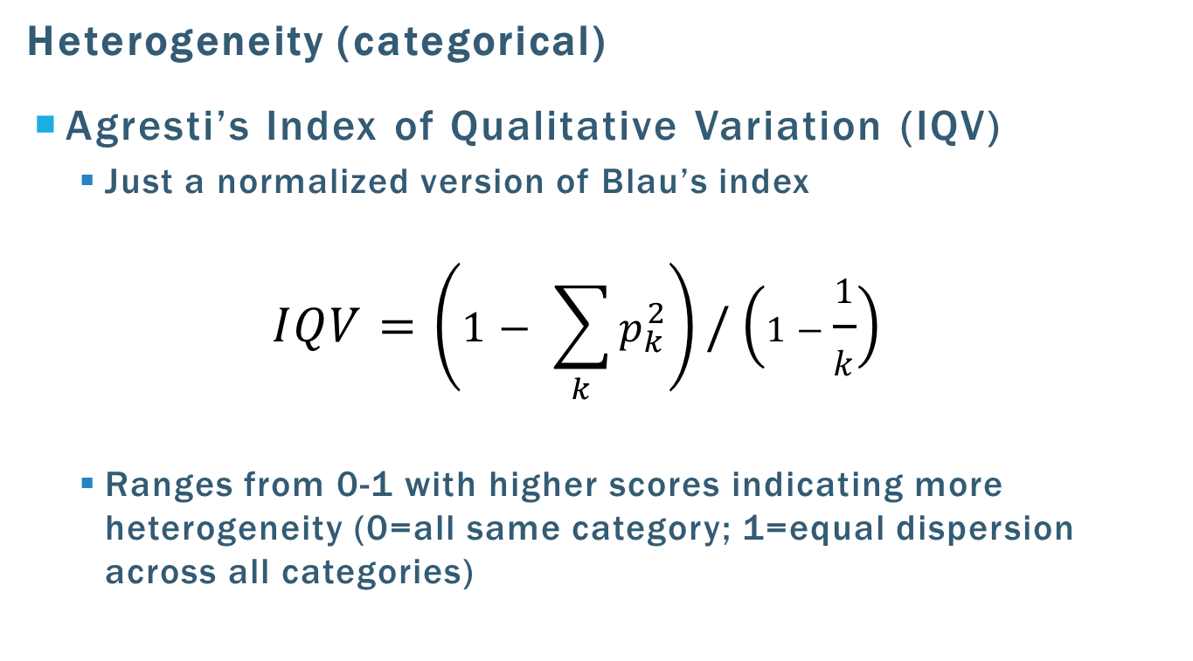
Heterogeneity
Heterogeneity (categorical)
Agresti’s Index of Qualitative Variation (IQV)
Just a normalized version of Blau’s index
$$IQV=\left(1− \sum_{k}{p_{k}^{2}}\right)/\left(1−\frac{1}{k}\right)$$
Ranges from 0-1 with higher scores indicating more heterogeneity (0=all same category; 1=equal dispersion across all categories)

Slide 28
Heterogeneity
Heterogeneity (categorical)
Is normalized version always better?
Not if using heterogeneity to measure diversity (e.g. of ideas)
E.g. someone with five kinds of alters probably experiences more diversity than someone with two kinds, even if alters are uniformly distributed across categories

Slide 29
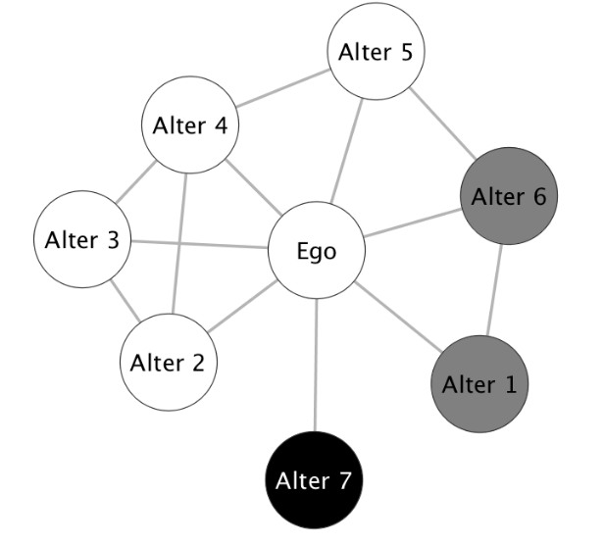
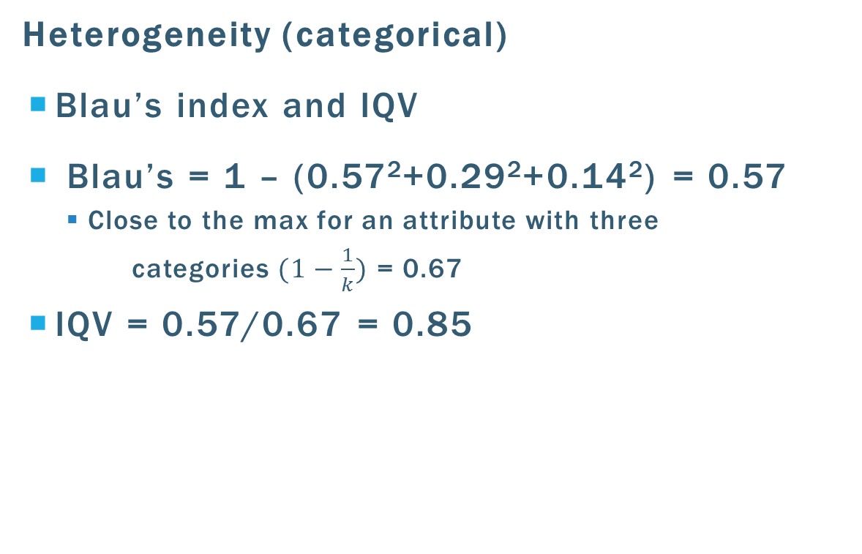
Heterogeneity
Heterogeneity (categorical)
Blau’s index and IQV
Blau’s = 1 – (0.57²+0.29²+0.14²) = 0.57
Close to the max for an attribute with three
categories $(1−\frac{1}{k})$ = 0.67
IQV = 0.57/0.67 = 0.85

Slide 30
Heterogeneity
Heterogeneity (continuous)
Standard deviation across the distribution of alters
E.g. SD of years of education for “population” of alters

Slide 31
Alter-alter ties
Ties may be binary or valued (if valued, can dichotomize)
Info about ties (or lack of ties) between alters is essential for computing all good measures of network structure
Usually, we are interested in operationalizing outcomes or characteristics of structural holes
Have been linked to innovation (Ahuja 2000), good ideas (Burt 2004), knowledge transfer (Abbasi et al. 2012), individual performance (Cross and Cummings 2004), and health (Cornwell 2009)

Slide 32
Alter-alter ties
Burt’s structural holes
The absence of a tie between two alters
Operationalizes two types of social capital:
Information – The more everyone knows everyone else, the more likely it is that information is redundant (and can extend to other resources)
Power – an ego who bridges two networks is able to control the flow of information and resources between them, and is less constrained by those alters
E.g. if my network ties don’t know each other, I can lie to them, present myself differently, play them off of one another

Slide 33
Alter-alter ties
Burt’s structural holes
In network 1, actor A is not in a strong bargaining position because both B and C have alternative exchange partners
In network 2, actor A has an advantaged position as a direct result of the "structural hole" between B and C
A has two alternative exchange partners; B and C have only one choice
1
2
A
B
A
B
C
C
Three actor network with no structural holes
Three actor network with one structural hole

Slide 34
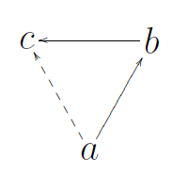
Alter-alter ties
Coleman’s closure
Converse of structural holes is triadic closure, or transitivity
Coleman (1988) associated closure (rather than structural holes) with social capital
Closure → shared social norms that effectively guide the actions of an individual, interpersonal trust, obligation to group members, cohesion, cooperation
Really, same mechanism (constraint) which may be beneficial or not depending on context
Hence two kinds of social capital – bridging and bonding
Notes:
E.g. constraint is great in a neighborhood where people all watch out for one another’s house and kids, etc., not so great when you are trying to get a job through access to new info about job leads

Slide 35
Alter-alter ties
Density
How many of ego’s alters are connected, controlling for network size?
Strength of social safety net
Strength of normative pressure to conform
Very powerful in combo with composition (direction of push), e.g. use of contraception in Kenya (Kohler et al. 2001)
More redundancy of info and resources (lack of structural holes)
E.g. low density → adaptation and resilience after divorce (Wilcox 1981)

Slide 36
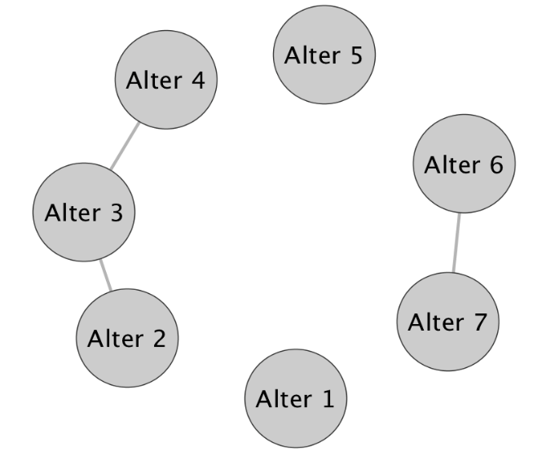


Alter-alter ties
Density
Actual ties/potential ties
Undirected ties
Directed ties
$$\frac{2T}{\left.N(N−1\right)}$$
$$\frac{T}{N(N−1)}$$
Sparsely-knit, with 3 of 42 possible ties present
Density = (2*3)/(7*(7-1)) = 0.14

Slide 37
Alter-alter ties
Effective size
If ego has ties to alters who are also tied to each other, there is lots of redundancy
Redundancy = ties where alters can be reached through multiple direct and indirect pathways
Effective size measures how many different “pots” of information ego can access
Effective size conveys something about ego's total impact

Slide 38
Alter-alter ties
Effective size
Ego’s number of alters minus the average number of ties that each alter has to other alters
Effective size is a positive function of network size, and a negative function of the number of ties among alters
D
B
D
B
A
A
C
C
Effective size = 3
Effective size = actual size – redundancy = 3-2 = 1

Slide 39
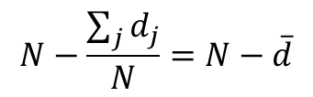
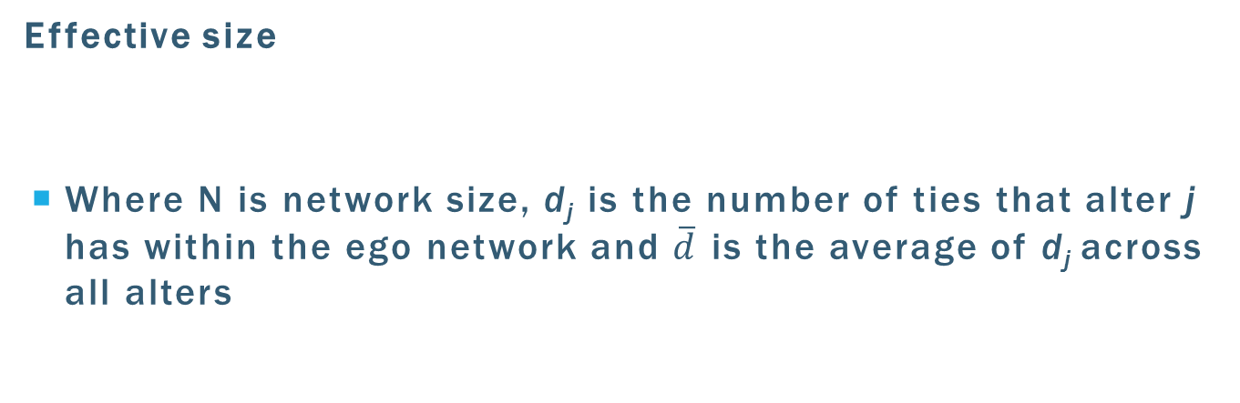
Alter-alter ties
Effective size
Where N is network size, d_{j} is the number of ties that alter j has within the ego network and $\overline{d}$ is the average of d_{j} across all alters
$$N−\frac{\sum_{j}{d_{j}}}{N}=N−\overline{d}$$
Network size = 7
Alters 1 and 5 are isolates
Alters 2, 4, 6, 7 are connected to one other alter
Alter 3 is connected to two alters
Mean ties per alter = (0+0+1+1+1+1+2)/7 is 0.9
Effective size = 7 – 0.9 = 6.1

Slide 40
Alter-alter ties
Efficiency
Efficiency is very similar to effective size except that it is normed by actual size (degree)
i.e. what proportion of ego's ties to alters are "non-redundant“
Effective size/Network size
Social capital per unit of relational energy (i.e. how much bang for your buck)
May convey social and political skill, or extent to which ego chooses ties wisely to maximize this

Slide 41
Alter-alter ties
Constraint
A measure that taps the extent to which ego's ties are to alters who are connected to one another
If ego's potential trading partners all have one another as potential trading partners, ego’s behavior is highly constrained
However, if ego's partners do not have alternatives, they cannot constrain ego's behavior
Important because it reflects that egos with many alters may actually lose freedom rather than gain it (depending on ties among alters)

Slide 42
Alter-alter ties
Hierarchy
Describes the nature of constraint on ego
If constraint is concentrated in a single alter, the hierarchy measure will have a higher value
If the constraint results more equally from multiple alters, hierarchy will be lower
Important because it reflects dependency
i.e. inequality in the distribution of constraints on ego across the alters in the network

Slide 43
MANAGING
EGOCENTRIC DATA

Slide 44
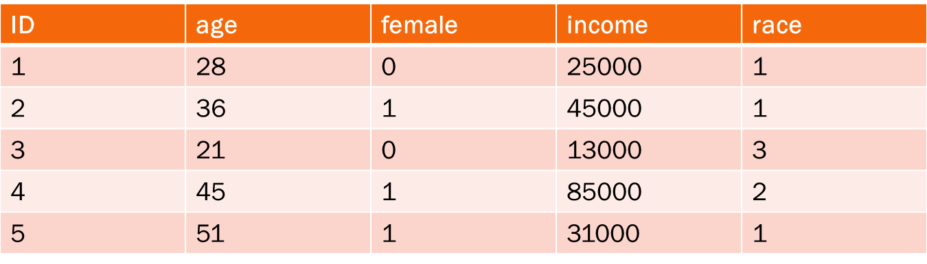
conventional data structure
2-by-2 matrix in which rows (cases or observations) are entities or objects and columns (vectors or variables) are attributes
How to store multilevel ego/alter data?

Slide 45
Conventional structure modified for networks
Option 1: Conventional data structure modified for networks
Ego attributes in columns
Tie and alter attributes in columns, numbered sequentially
Alter-alter ties conveyed through columns

Slide 46
Conventional structure modified for networks
age = ego’s age
female = ego’s gender
aage1 = age of first alter named
atie1 = how ego and alter 1 are connected (e.g. kin, friend)
aclose1 = closeness of ego to alter 1
aage2 = age of second alter named
ID | age | female | aage1 | atie1 | aclose1 | aage2 | atie2 | aclose2
1 | 28 | 0 | 18 | 4 | 2 | 22 | 3 | 1
2 | 36 | 1 | 45 | 1 | 1 | 46 | 1 | 3
3 | 21 | 0 | 33 | 3 | 1 | 63 | 1 | 2
4 | 45 | 1 | 27 | 2 | 3 | 43 | 5 | 2
5 | 51 | 1 | 31 | 1 | 1 | 19 | 3 | 1

Slide 47
Conventional structure modified for networks
SAME data file
Alter-alter ties can be valued (e.g. on likert scale) or 0/1
afrnd1-2 = friendship between alters 1 and 2?
afrnd1-3 = friendship between alters 1 and 3?
afrnd1-4 = friendship between alters 1 and 4?
afrnd2-3 = friendship between alters 2 and3?
ID | afrnd1-2 | afrnd1-3 | afrnd1-4 | afrnd2-3 | afrnd2-4 | afrnd3-4
1 | 0 | 0 | 1 | 1 | 0 | 0
2 | 0 | 1 | 1 | 0 | 1 | 0
3 | 1 | 0 | 0 | 0 | 1 | 0
4 | 1 | 1 | 0 | 1 | 1 | 1
5 | 1 | 1 | 1 | 0 | 1 | 0

Slide 48
Long-form (“TIDY”) data
OPTION 2: Data file structured in long form
Each row is a tie or alter
Ego attributes are embedded in columns
Consistent with multilevel (hierarchical) data structure

Slide 49
Long-form (“TIDY”) data
Ego 1 has three ties; ego 2 has two ties; ego 3 has three ties
Variables age, female, and race are attributes of ego (same for all alters, or rows, linked to that ego)
Variables aage, atie, aclose, and asmoker are attributes of the tie or alter (differ in each row)
egoID | alterID | age | female | race | aage | atie | aclose | asmoker
1 | 1 | 28 | 0 | 2 | 46 | 1 | 4 | 0
1 | 2 | 28 | 0 | 2 | 52 | 4 | 1 | 1
1 | 3 | 28 | 0 | 2 | 19 | 3 | 3 | 1
2 | 1 | 45 | 1 | 1 | 23 | 2 | 2 | 0
2 | 2 | 45 | 1 | 1 | 47 | 3 | 1 | 1
3 | 1 | 53 | 0 | 3 | 61 | 2 | 1 | 1
3 | 2 | 53 | 0 | 3 | 33 | 1 | 2 | 0
3 | 3 | 53 | 0 | 3 | 39 | 1 | 3 | 0

Slide 50
Long-form (“TIDY”) data
Adjacency matrix is a characteristic of ego
Values in adjacency matrix are the same for all alters, or rows, linked to a given ego
Relations that do not exist are missing (NA in R)
egoID | alterID | age | female | aage | atie | know1-2 | know1-3 | know1-4 | know2-3
1 | 1 | 28 | 0 | 46 | 1 | 1 | 0 | NA | 1
1 | 2 | 28 | 0 | 52 | 4 | 1 | 0 | NA | 1
1 | 3 | 28 | 0 | 19 | 3 | 1 | 0 | NA | 1
2 | 1 | 45 | 1 | 23 | 2 | 0 | NA | NA | NA
2 | 2 | 45 | 1 | 47 | 3 | 0 | NA | NA | NA
3 | 1 | 53 | 0 | 61 | 2 | 0 | 1 | NA | 1
3 | 2 | 53 | 0 | 33 | 1 | 0 | 1 | NA | 1
3 | 3 | 53 | 0 | 39 | 1 | 0 | 1 | NA | 1

Slide 51
Transforming data
Can transform ego network data into different structural forms easily
Use R’s reshape command to transform data from option 2 (multilevel) to option 1 (conventional) and back

Slide 52
COMPUTING MEASURES

Slide 53
Egocentric network analysis
Egocentric network analysis poses problems:
Have data at two different levels, which is not suitable for traditional analysis techniques
However, most SNA tools (designed for whole network data) are ill-suited for ego analysis
Require joining many ego networks into one very sparse network
OR, repeat analyses for all ego networks in the sample

Slide 54
Egocentric network analysis
Two strategies for dealing with these complications:
1) Aggregate everything to the ego level and analyze in conventional ways
Analytically straightforward
Limited compared to what you can do with MLM
2) Use multilevel model, alters nested in egos
Analytically complex (relative to previous)
Only for DV that varies within ego (i.e., across alters)
Super cool

Slide 55
Aggregation to ego level
Use conventional statistical software programs to aggregate alter- and tie-level data to the ego level
Then, use standard regression tools
Some measures are too complicated to reasonably be calculated “by hand”
We can use E-Net to facilitate this

Slide 56
CREATING MEASURES IN E-NET

Slide 57
E-NET
SNA tool available for free from www.analytictech.com
Accepts data in conventional (wide) format Excel file
Has a built-in function to export data to other software packages
Calculate aggregated measures easily

Slide 58
From R to ENET via Excel
Once you have saved your data file as an Excel spreadsheet, import it into ENET
In ENET, go to File – Import

Slide 59
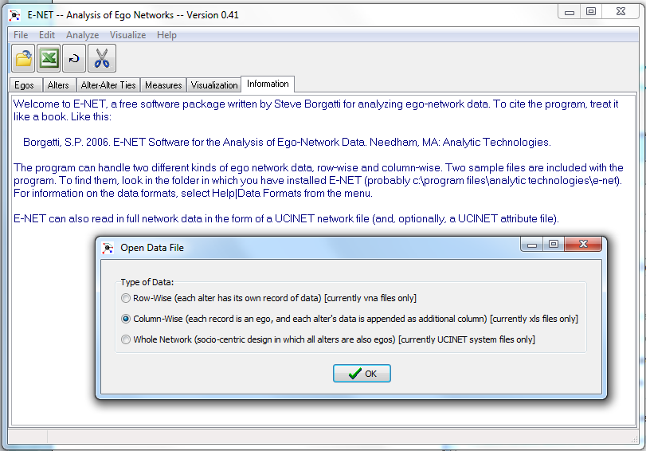

Slide 60
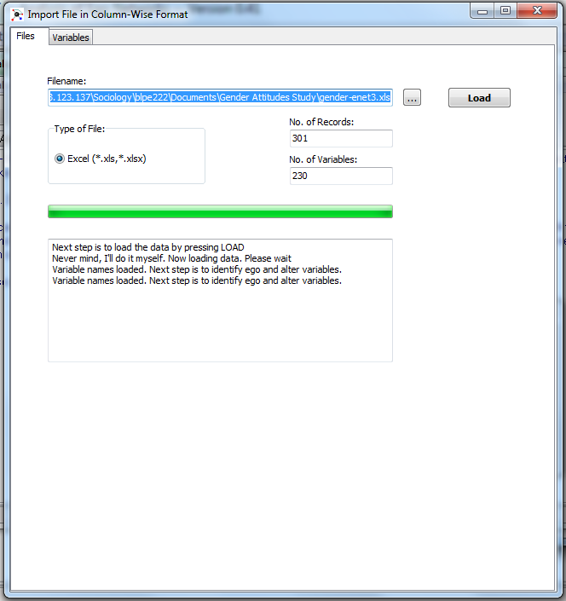
Number of cases
Number of variables

Slide 61
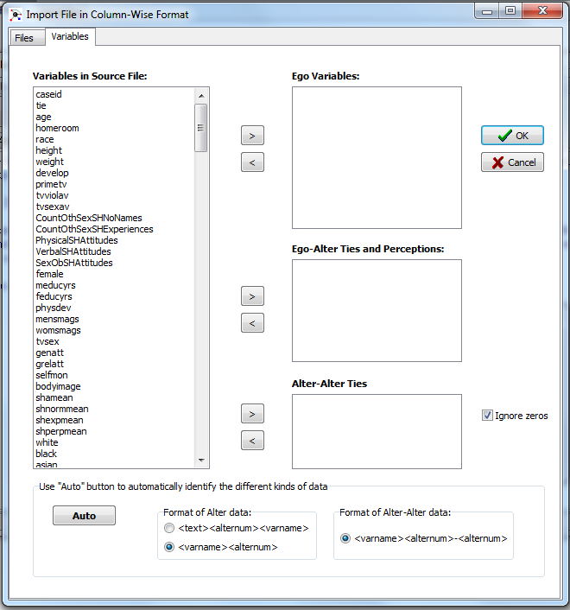
Can select and move yourself
Or if named properly, can use Auto

Slide 62
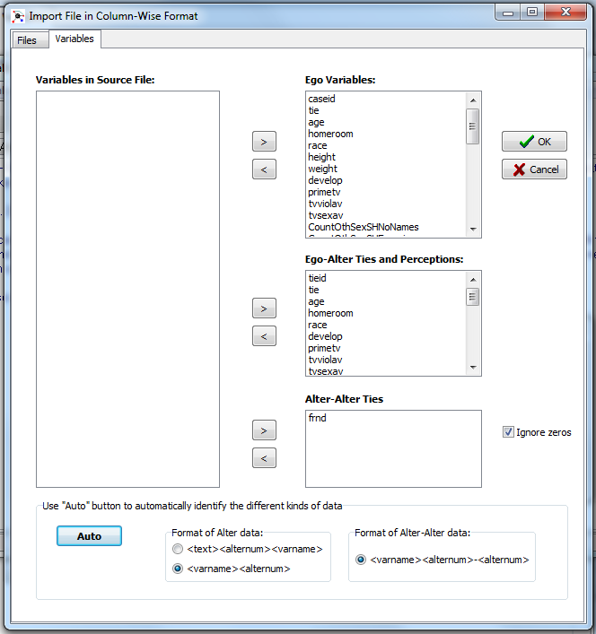

Slide 63
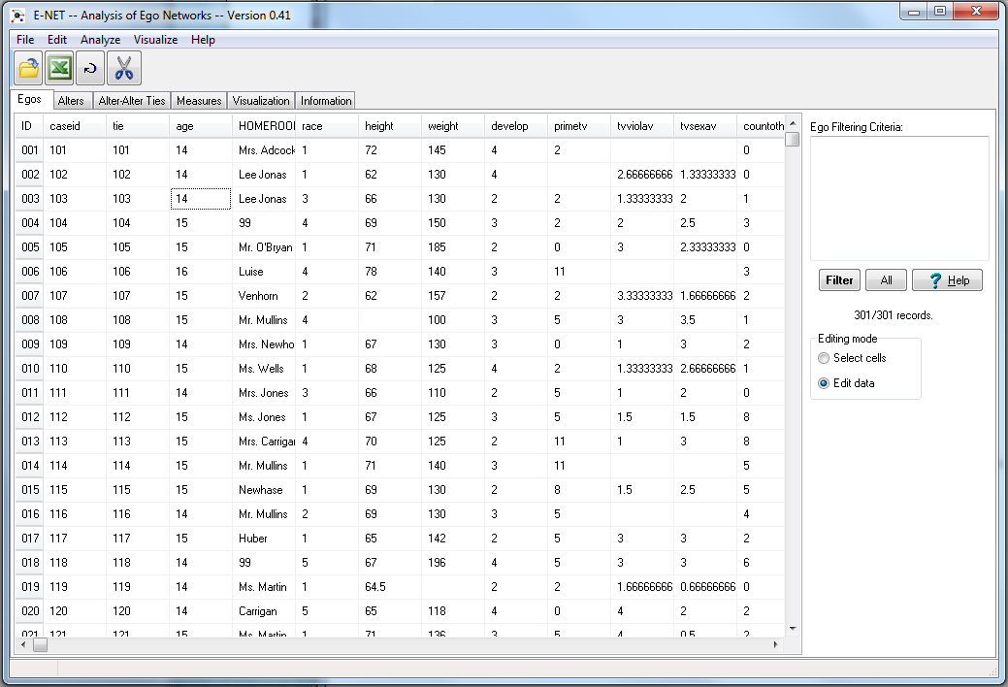

Slide 64
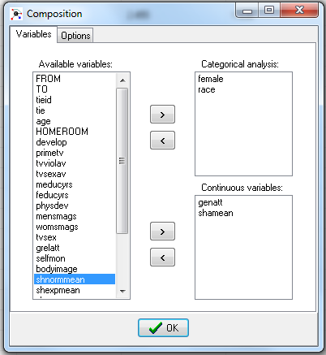
Calculating measures
Main advantage of ENET is quick calculation of network metrics

Slide 65
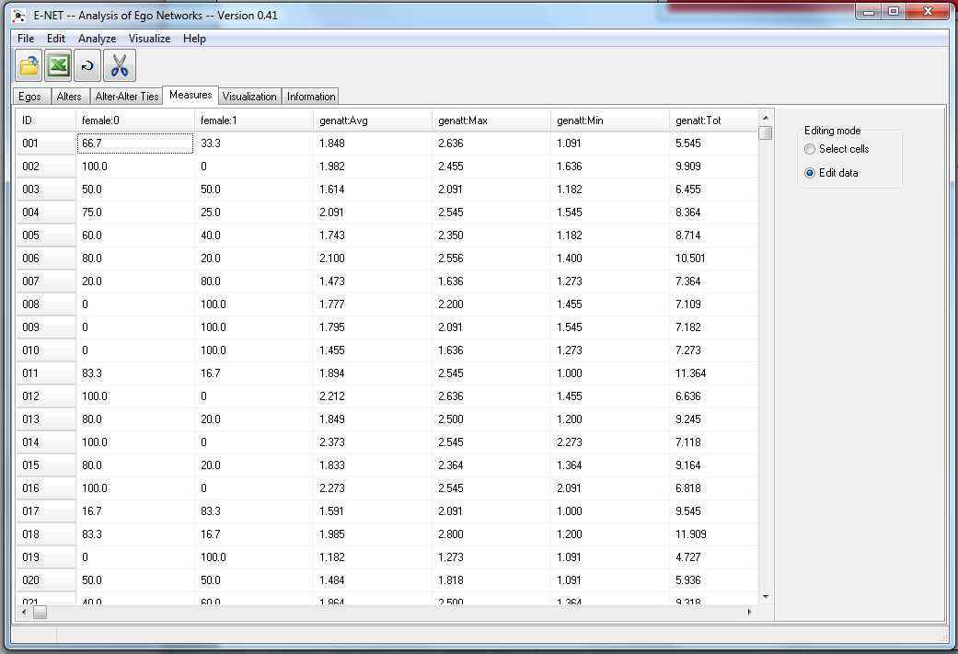

Slide 66
Output variables in ENET
Follow the format varname:measure
Variable name is sometimes abbreviated
Composition
varname:number = percent in that category
varname:Avg = mean
varname:Max = maximum
varname:Min = minimum
varname:Tot = sum

Slide 67
Output variables in ENET
Heterogeneity
varname:Het = Blau’s index
varname:Iqv = index of qualitative variation
varname:SD = standard deviation
Homophily
varname:SameProp = proportion same as ego
varname:E-I = E-I index
varname:AvgEucDist = average euclidean distance
Structural variables are obvious

Slide 68
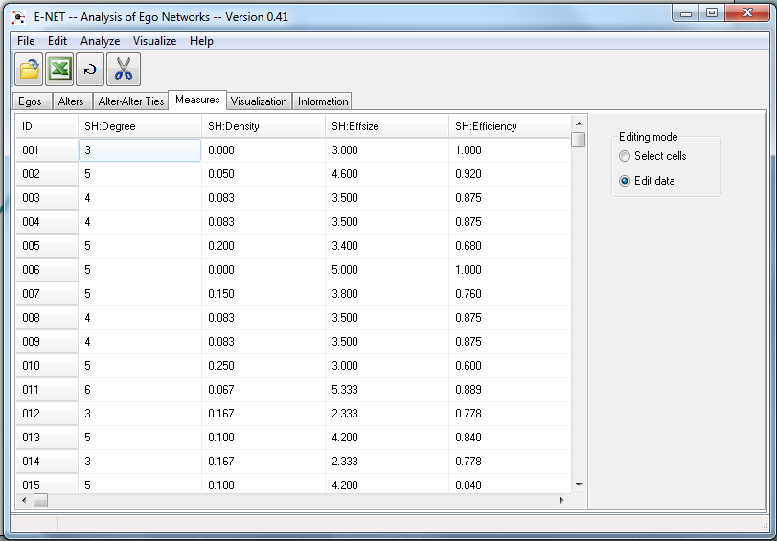
And back to R
Once you have your measures, transfer them to the Egos tab
Then, create Excel file and save

Slide 69
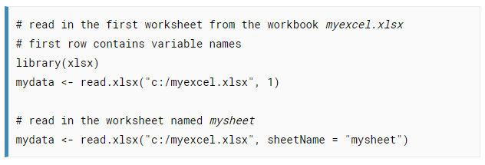
And back to R

Slide 70
EGO NETWORKS IN MULTIVARIATE REGRESSION

Slide 71
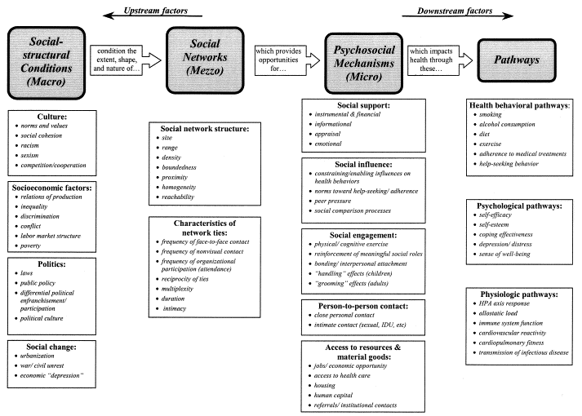
Networks as independent variables
Social integration
Lisa Berkman

Slide 72
Common model violations in network research
Multicollinearity
Non-linear relationships
Skew
Heteroskedasticity

Slide 73
Parallel play
Regression in R

Slide 74
MULTILEVEL MODELS

Slide 75
Two major parts of any model
Part I: Model for the means
AKA fixed effects part of the model (i.e., fixed parameters)
What you are used to caring about for testing hypotheses
How the expected outcome for a given observation varies on average as a function of values of predictor variables

Slide 76
Two major parts of any model
Part II: Model for the variances
AKA random effects and residuals (i.e., stochastic or varying parameters)
What you are used to making assumptions about
How residuals are distributed and related across observations (persons, groups, time, etc.) are the primary way that multilevel models differ from general linear models (e.g., regression)

Slide 77
WHEN AND WHY TO USE AN MLM FOR EGO NETWORK RESEARCH

Slide 78
MLM for social networks
When to use MLM for ego SNA: Formal requirements
DV is an alter or tie-level variable (level-1)
If you are interested in predicting a characteristic of ego (e.g. health, employment outcomes, movement participation), MLM is not appropriate
IVs can be alter, tie, network, or ego-level variables (level-1 or 2)
Personal networks of egos do not overlap (or overlap is negligible)
Ego observations are independent of one another

Slide 79
MLM for social networks
Why to use MLM for ego SNA
Vs. aggregation to ego level
Aggregation = loss of information
Vs. standard error adjustments
You can explicitly model the effects of characteristics at the level of ego, alters, dyads, and networks, and their interactions (vs. e.g. cluster robust SEs)

Slide 80
MLM research questions
What affects formation of ties to alters with particular attributes?
What affects alter behavior or contributions?
What affects characteristics of dyads, or ties between egos and alters?
Does network context moderate the effect of ego or alter-level characteristics?

Slide 81
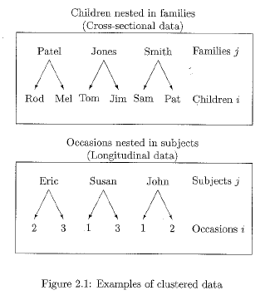
Dependency
Alter obs nested in same ego are not independent

Slide 82
Dependency
Ignoring multi-level structure depresses standard errors, makes it easier to find significance when there really is none
Multilevel model accounts for clustering (non-independence) and allows you to explicitly model it rather than just control for it

Slide 83
Random intercept model
We are just making piles of variance, not reducing overall variance
Random intercept MLM
OLS
Residual Variance
$$ε_{ij}$$
Residual Variance
$$ε_{i}$$
Random Intercept
$$ζ_{j}$$

Slide 84
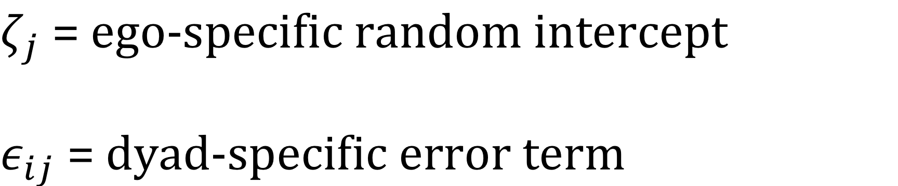
Random intercept model
epsilon
zeta
Explicitly model the error dependence by splitting up the error term into level-1 (dyad) and level-2 (ego) components
Have a random intercept for level-2 ego j that is constant across all level-1 alters
Have an error term for each dyad or alter i clustered within ego j

Slide 85
Intraclass correlation
rho
$\frac{ψ}{ψ+θ}$ = $ρ$
theta
$θ$ = variance within clusters
$φ$= variance between clusters
psi
Rho is a measure of between-cluster heterogeneity OR within-cluster homogeneity (two sides of the same coin)
Typically call it the intraclass correlation, which is a measure of within-cluster correlation

Slide 86
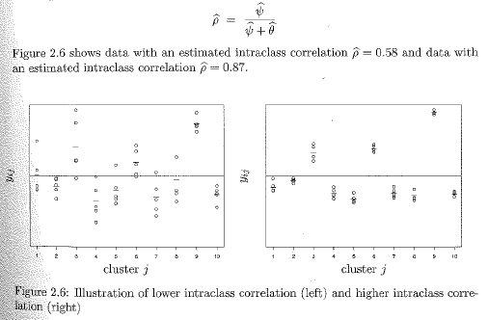
Intraclass correlation

Slide 87
Intraclass correlation
ICC is a standardized way of expressing how much we need to worry about dependency due to cluster mean differences
Bigger ICC → more messed up standard errors

Slide 88
Random intercept model
Now see ij subscript, which denotes alter i of ego j

Slide 89





What relationship factors affect libido?
$$ε_{DonJuan−Jane}$$
$$ε_{Bob−Jane}$$
$$ζ_{Jane}$$
$$ε_{Ann−Jane}$$
$$β_{0}$$
Ego Jane has three sex partners – Bob, Ann, and Don Juan
The intercept is 6 sexual contacts per month
What can we say about ego Jane and her sex partners?

Slide 90








What relationship factors affect libido?
$$ε_{DonJuan−Jane}$$
Variation within
$$ε_{Bob−Jane}$$
$$ζ_{Jane}$$
$$ε_{Ann−Jane}$$
Variation between
$$β_{0}$$
$$ζ_{Joe}$$
$$ε_{Amy−Joe}$$
Variation within
$$ε_{Sue−Joe}$$
Two egos Jane and Joe and five sex partners (dyads)
What can we say about within and between variation?

Slide 91
Communication and libido
Both Jane and Joe get their own random intercept
Jane’s regression line
y = # sexual contacts
Joe’s regression line
$$β_{0}$$
0
1
2
3
x = quality of communication

Slide 92
Communication and libido
Ego’s get their own random intercept based on their alter/tie observations
Every ego gets their own regression line
Intercept is “random” (varies)
Slope is constant
y = # sexual contacts
Overall intercept $β_{0}$ reported in Stata output is a weighted average of each ego’s intercept
Not the same intercept you would get if you used level-1 observations to calculate
Usually similar
$$β_{0}$$
0
1
2
3
x = quality of communication

Slide 93
Parallel play
Random intercept
model in R

Slide 94
Running MLM in R
Suppose we want to look at the effects of ego and alter gender on the number of support functions provided by an alter to an ego
$$y_{ij}=β_{0}+β_{AltFem}x_{ijAltFem}+β_{EgoFem}x_{jEgoFem}+{ζ_{j}+ ε}_{ij}$$

Slide 95
Empty RI model
SD of the random intercepts
SD of the residuals
y intercept
Distribution of residuals (standardized)

Slide 96
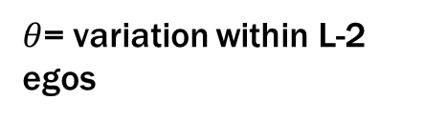
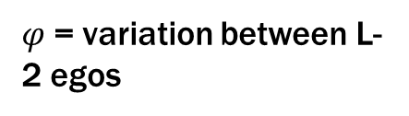
Empty RI model
We usually prefer to report the variance rather than the SD of random components, and we need the variance to calculate ICC
$φ$= variation between L-2 egos
$θ$= variation within L-2 egos

Slide 97
Empty RI model

Slide 98
RI model with predictors

Slide 99
CLUSTER CONFOUNDING AND CONTEXTUAL EFFECTS

Slide 100
Cluster confounding: A major threat to RE models
The RE model assumes that Level-1 (alter) covariates are uncorrelated with the random intercept
Problematic because every Level-1 variable varies both within and between clusters (ego networks)
Put another way, all Level-1 alter variables contain information about alters and networks
Can’t assume a variable has the same effect at both levels

Slide 101
Contextual effects
Add a contextual effect of alter/tie-level variables by including the aggregated network version of the variable
E.g., alter closeness and cluster-mean of closeness (avg closeness across network)
Called “contextual effect” because it tests whether cluster (i.e., network) effects have any significant influence over and above the alter/tie-level effect

Slide 102
Parallel play
Contextual effects
in R

Slide 103
Contextual effects in R
Maybe being in a network full of women affects how much support each alter provides to ego, above and beyond alter’s own gender.
First, create contextual (aggregated) network variables using ave command

Slide 104
Contextual effects in R

Slide 105
THE RANDOM
COEFFICIENT MODEL

Slide 106
Random coefficient model
The random intercept model is based on the premise that each Level 2 ego needs its own random intercept to account for dependency of Level 1 alters within networks
The effects of any independent variable x (the slope) across Level 2 clusters are assumed to be equal (constant)

Slide 107
Communication and libido
Jane’s regression line
y = # sexual contacts
$$β_{0}$$
Joe’s regression line
0
1
2
3
x = quality of communication

Slide 108
Random coefficient model
The random coefficient linear regression model:

Slide 109
Communication and libido
$$ε_{1Jane}$$
Jane’s regression line
y = # sexual contacts
$$ζ_{1Jane}$$
$$β_{1}$$
$$ζ_{0Jane}$$
$$β_{0}$$
Joe’s regression line
0
1
2
x = quality of communication

Slide 110
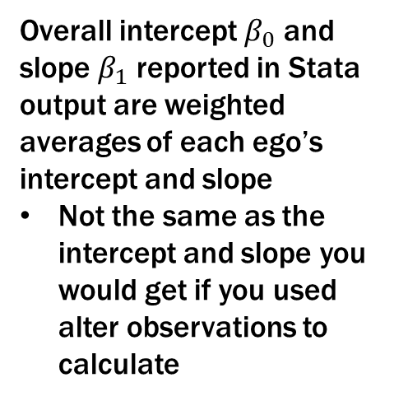
Communication and libido
Egos get their own random intercept and slope based on their alters
Every ego gets their own regression line
Intercept is “random” (varies)
Slope is “random” (varies)
y = # sexual contacts
Overall intercept $β_{0}$ and slope $β_{1}$ reported in Stata output are weighted averages of each ego’s intercept and slope
Not the same as the intercept and slope you would get if you used alter observations to calculate
$$β_{0}$$
0
1
2
3
x = quality of communication

Slide 111
Random coefficient model
We are still just making piles of variance, not reducing overall variance
Random coefficient MLM
Random intercept MLM
Residual Variance
$$ε_{ij}$$
OLS
Residual Variance
$$ε_{ij}$$
Residual Variance
$$ε_{i}$$
Random Slope
$$ζ_{1j}$$
Random Intercept
$$ζ_{j}$$
Random Intercept
$$ζ_{0j}$$

Slide 112
Parallel play
Random coefficient
Model in R

Slide 113
RC model in R
Suppose I wanted to know if the effect of alter gender on support provision varies across egos…
Why might this be true?

Slide 114
RC model with predictors
I perform a nested Likelihood Ratio test using stored estimates to determine whether the random slopes are significantly different from zero…
If p-value is less than .05, I reject the null hypothesis that the random coefficients are equal to zero and use random coefficient model

Slide 115
RC model
SD of the random intercepts
SD of the random slopes
SD of the residuals

Slide 116
RC model
Correlation between random slopes and random intercepts
Correlation of .13 between random slopes and intercepts suggests that in ego networks that provide more support functions, on average (intercept), the effect of alter gender (slope) is larger compared to networks that support less.

Slide 117
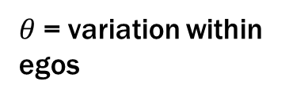
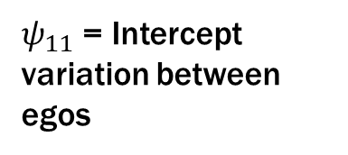
RC model
$ψ_{11}$ = Intercept variation between egos
$ψ_{22}$= Slope variation between egos
$θ$= variation within egos
Intraclass correlation

Slide 118
CROSS-LEVEL
INTERACTIONS

Slide 119
Cross-level interactions are cool!
Level-1 (alter/tie) variables and Level-2 (network/ego) variables interact to produce an effect on some outcome
Usually, how does the effect of some alter-level variable vary as a function of network context or some ego characteristic
Not that different from regular interactions, except that you want to make sure you’re using a random coefficient model. Why?

Slide 120
Parallel play
Cross-level interactions
Model in R

Slide 121
Cross-level interactions in R
Suppose I wanted to know if the effect of alter gender differs for male and female egos…
Why might this be true?

Slide 122
Cross-level interactions in R
Effect of alter gender when ego gender= 0
Effect of network gender comp. when ego gender= 0
Change in effect of alter gender when ego gender=1
Change in effect of network gender comp. when ego gender=1

Slide 123
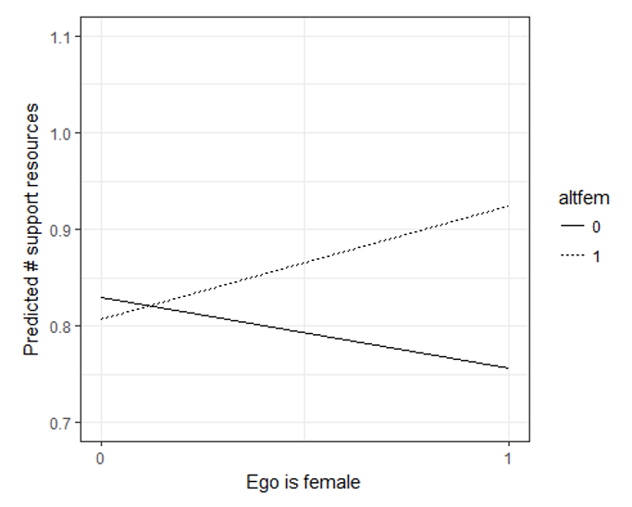
Cross-level interactions in R
When ego is a man, there is no significant effect of an alter being a woman (b=-0.02) on number of support functions. However, when ego is a woman, women alters are expected to provide 0.17 more support functions than men alters.
Interaction at Level-2 is
not significant

Slide 124
EGO NETWORK
DYNAMICS

Slide 125
What we know about social network dynamics
Structural properties of networks tend to remain fairly stable over time
BUT lots of “turnover” or “churn” in the individuals that make up a network
Toronto, Ontario residents: only 27% of ties persist over a decade (Wellman et al. 1997)
Loss of ties does not mean networks are getting smaller – may just be replacement

Slide 126
What we know about social network dynamics
Networks are comprised of two basic components:
a smaller and more stable core
Densely-knit, mostly kin, highly supportive
a larger set of temporary or sporadic ties (the periphery)
Most turnover occurs in periphery

Slide 127
What we know about social network dynamics
Periphery is a problem for cross-sectional network studies
People engage in periods of brief and sporadic periods of meaningful contact (e.g. old friend visits, weak tie provides info)
The likelihood of these sometimes-inactive relationships being present in a snapshot of a network is essentially random
When peripheral ties are not captured, they are assumed to be absent rather than inactive
Instability does not mean real change

Slide 128
How to measure network change
Problem 1: Real change or methodological artifact?
Respondents forget to name alters from previous waves 5-10% of the time
Respondents deliberately underreport alters in subsequent waves because they know each alter = more work
Respondents give different names or spellings in subsequent waves

Slide 129
How to measure network change
Problem 2: Determining what alter-level changes underlie network-level change
Suppose the mean freq of contact with network members decreases from W1 to W2. This can be due to…
ego decreasing contact with alters who were present at both W1 and W2
the loss of past alters with whom ego had frequent contact
and/or the addition of new alters with whom ego has infrequent contact

Slide 130
How to measure network change
Solution: Real change or methodological artifact?
In each follow-up wave of a study…
have egos name their current alters
show them their roster from the previous wave or waves
have them match alters across waves
ask them why they didn’t name any dropped alters, and add if they report forgetting

Slide 131
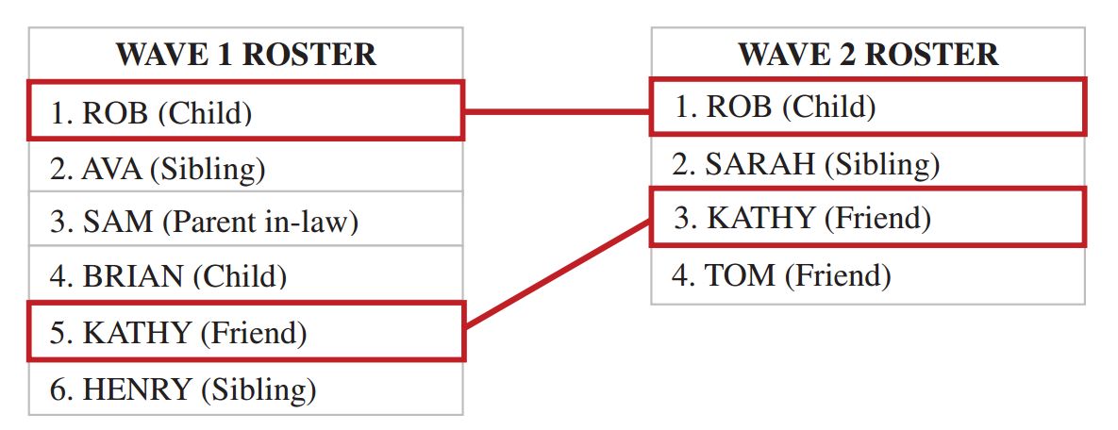
How to measure network change

Slide 132
Measures of network change
Measures that capture network turnover
N/Prop alters dropped
N/Prop alters added
N/Prop stable alters

Slide 133
Measures of network change
Network turnover, Perry & Pescosolido (2012)
N dropped or added
N unique alters pooled

Slide 134
How to analyze network change
If goal is to describe change:
Simple comparison of ego network characteristics over time
E.g., Avg degree at W1 compared to avg at W2
Measure of difference between two waves
E.g., W2 degree – W1 degree

Slide 135
How to analyze network change
If goal is to describe change:
Distinguish alters dropped, maintained, or added across W1 and W2
Can present number or percent of each
E.g., 35% of alters dropped, 35% maintained, 30% added
Compare characteristics of each
E.g., 75% of maintained alters are “very close” compared to 35% of dropped alters

Slide 136
How to analyze network change
If goal is to predict network change or use network change to predict outcomes
Use longitudinal multilevel models
Same as earlier, but now have observations over time nested in egos (or obs nested in alters nested in egos)
Requires a special class of MLM called growth models that explicitly estimate the effects of time and time*predictors

